Slide 1

Tic-Tac-Toe model
A reinforcement learning personal challenge made by
Anne E. J. Koppers

Slide 2
The lost project (Atari Go)
First idea
Changes
Difficulty
What I learned

Slide 3
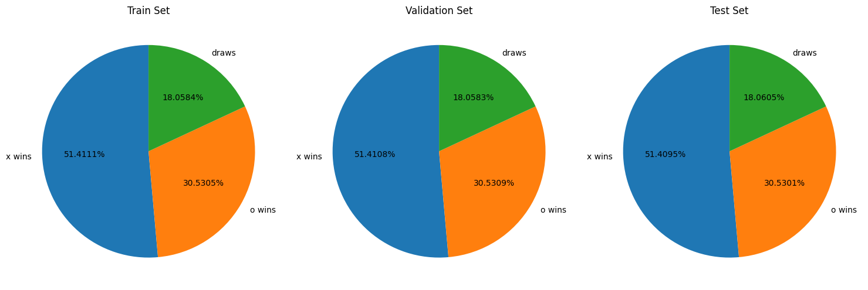
New horizons (tic-tac-toe)
Start
Testing
Changing reward structure
Pretraining a model

Slide 4
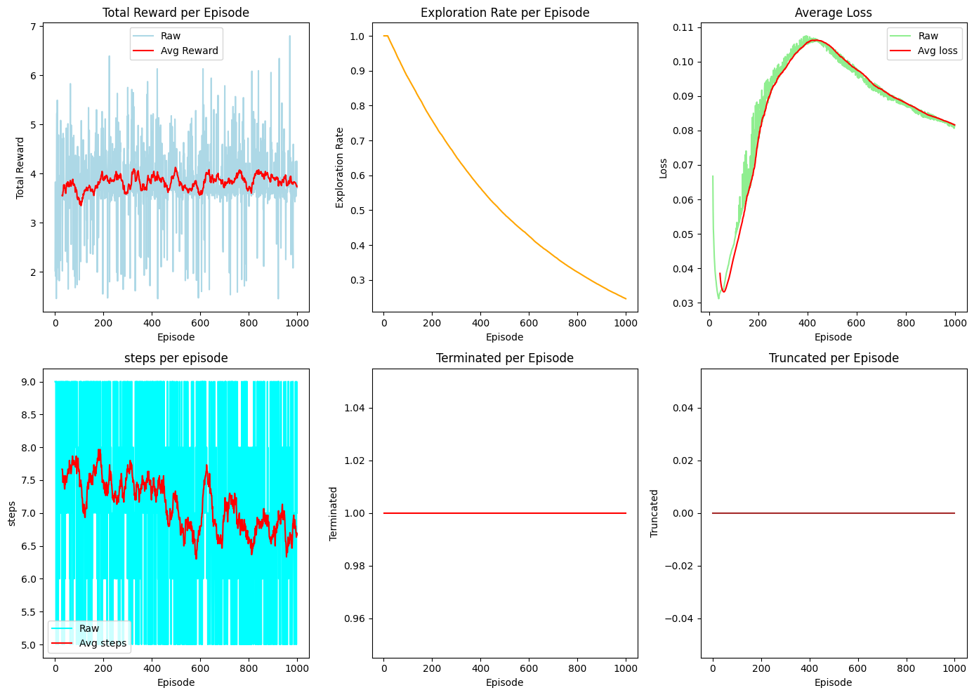
start
Agent
Envirement
Training
evaluating

Slide 5
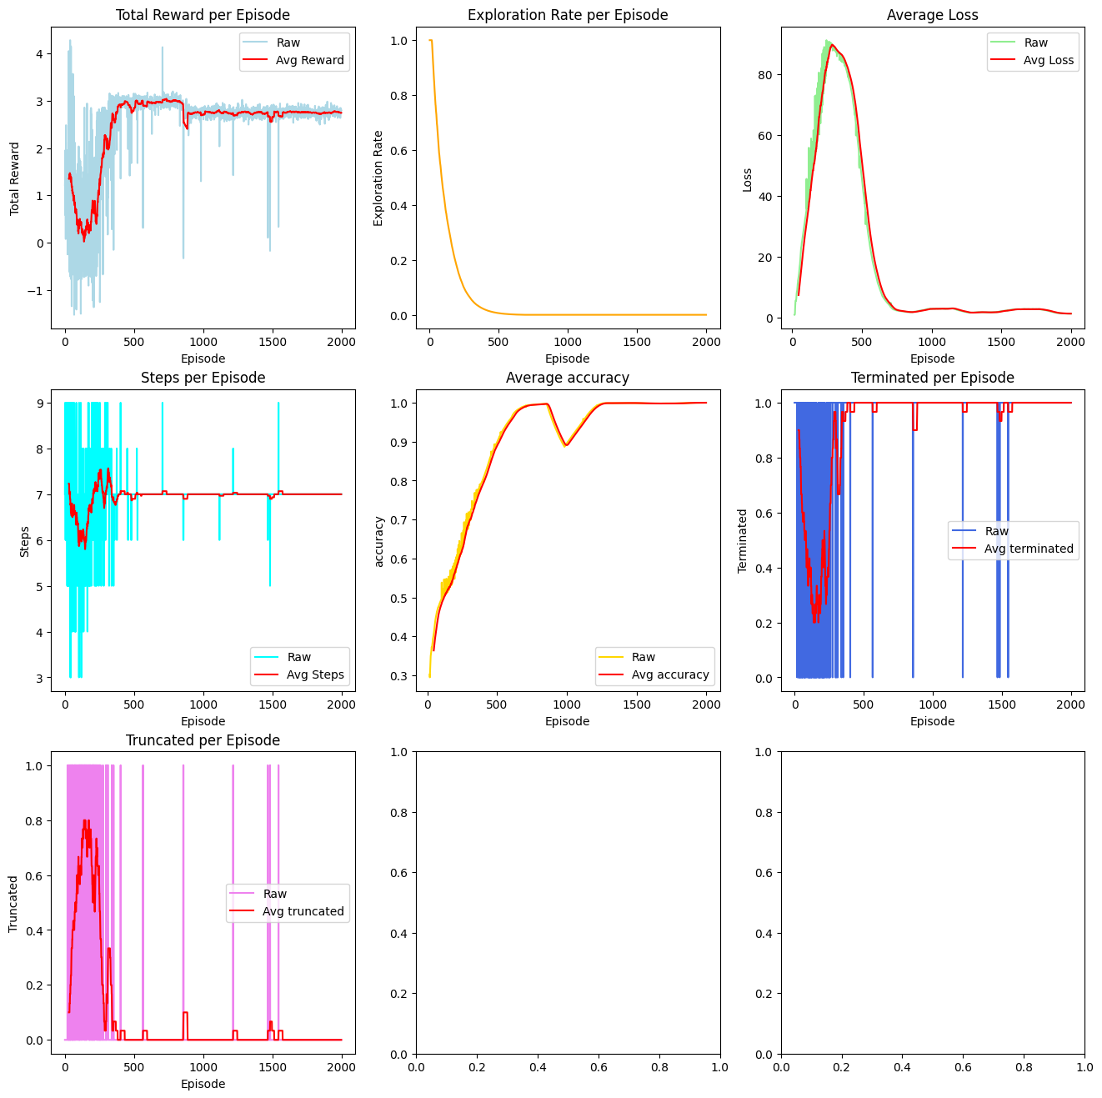
Testing
Logging
Seeing
Changing
repeat

Slide 6
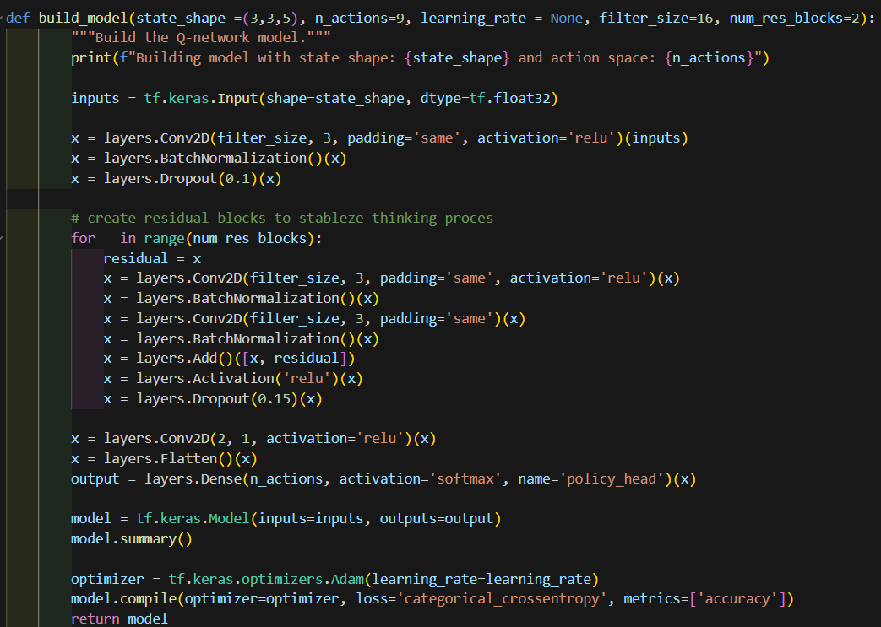
Pretraining a model
Shape (3,3,5)
conv2d Layers
Residual blocks
Dropout
Output (9)
Batch normalization
Flatten

Slide 7
Changing reward structure
Monte Carlo
Random/simple Monte Carlo
Monte Carlo Tree Search (MCTS)
Memory leaks
Transferflow schematics
Monte Carlo Tree Search branches/nodes

Slide 8
Retrospect
Fun but hard
01
Learned about RL training for games
02
How to detect and mitigate memory leaks.
03
Learned about Monte Carlo implantations.
04

Slide 9

questions

